Slide 1

SUBJECT – E-Commerce & ERP
ASANSOL ENGINEERING COLLEGE
SUB CODE - OEC-IT802A
TOPIC: INTRODUCTION OF ERP
PRESENTED BY:-
NAME – AISHWARYA GHOSH
ROLL NO. – 10800219074
REG NO.- 036064 OF 2019-20
DEPT – INFORMATION TECHNOLOGY
YEAR – 4TH YEAR (8TH SEM)

Slide 2
INTRODUCTION OF ERP
ERP stands for Enterprise Resource Planning.
ERP systems are the kind of software tools which are used to manage the data of an enterprise. ERP system helps different organizations to deal with different departments of an enterprise. Different departments like receiving, inventory management, customer order management, production planning, shipping, accounting, human resource management, and other business functions.
Basically, it is the practice of consolidating an enterprise’s planning, its manufacturing, its sales and marketing efforts into one management system.

Slide 3
ERP helps in automation of the tasks involved in performing a business process.
Before ERP :-
Before an ERP system, there are different databases of different departments which they managed by their own. The employees of one department does not know about anything about other department.
After ERP :-
After ERP system, databases of different departments are managed by one system called ERP system. It keep tracks of all the database within system. In this scenario, employee of one department have information regarding the other departments.

Slide 4
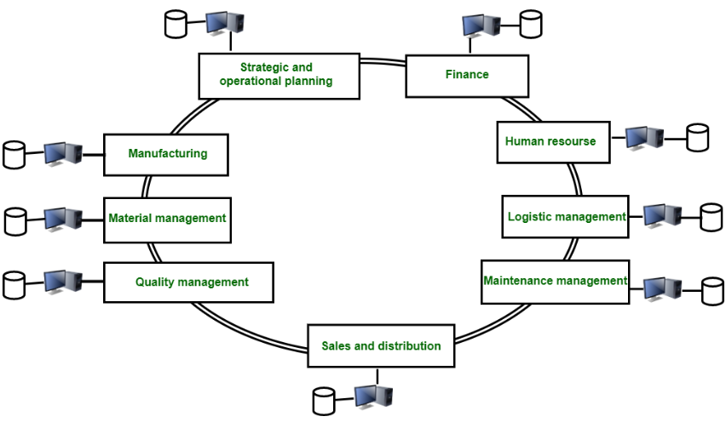
Before ERP :-

Slide 5
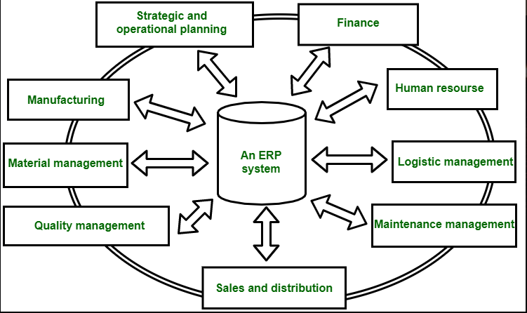
After ERP :-

Slide 6
Features of Erp
The real-time visibility of ERP systems improves decision-making, helps identify issues before they occur, and increases overall productivity.
It is an end-to-end view of your business, here are some common benefits of clearly-defined ERP systems:
1.Optimized operations:- Gain greater control over disconnected areas of your business through the automation, task prioritization, and data integration of ERP systems.
2. Aligned teams:- Increase business productivity, enable the flow of data between departments, and encourage collaboration by breaking down data silos.

Slide 7
3. Unified data:- Eliminate duplication, reduce errors, and boost data accuracy by maintaining a centralized repository for data from all departments.
4.Improved decision-making:- Make predictive insights and data-driven decisions with real-time information about your organization.
5.Reduced costs:- Reduce mistakes and uncover issues before they happen—insight across the business increases efficiency and reduces costs overall.

Slide 8
BENEFITS OF erp
Some benefits of ERP(Enterprise Resource Planning)
This system helps in improving integration.
It is the flexible system.
There are fewer errors in this system.
This system improved speed and efficiency.
There is a complete access to information.
Lower total costs in complete supply chain.
This system helps in Shortening the throughput times.
There is sustained involvement and commitment of the top management.

Slide 9
Limitations OF erp
ERP system has 3 significant limitations :
There is no proper decision-making scenario i.e. this systems provide only the current status, such as open orders. Whenever there is need to look for past status to find trends and patterns it become difficult that aid better decision-making.
Managers generate custom reports or queries only with the help from a programmer and this will create a problem that they did not receive information quickly, which is essential for making a competitive advantage.
No doubt that data is integrated within the system, but there is no integration of data with other enterprise or division systems and it does not include external intelligence.

Slide 10
THANK YOU

